Slide 1
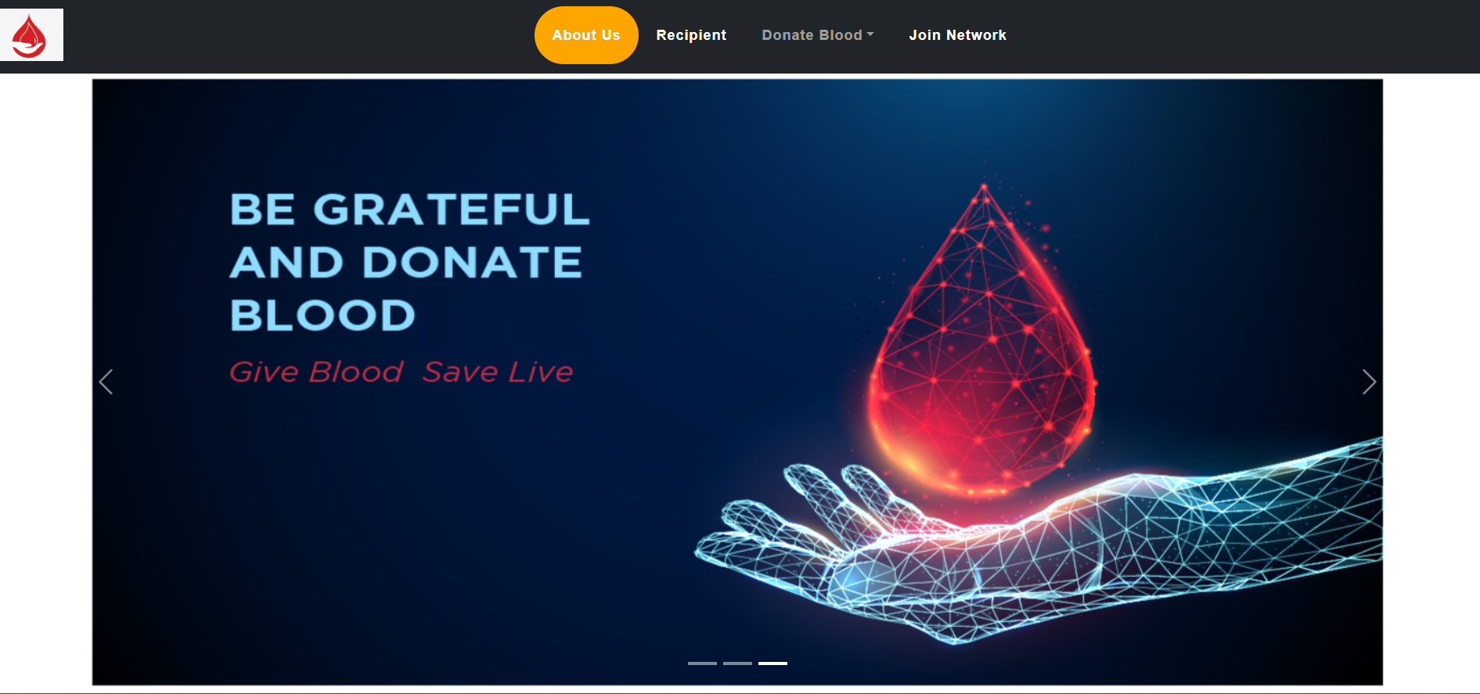
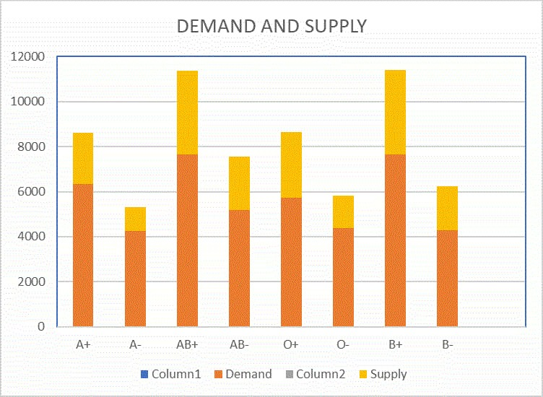

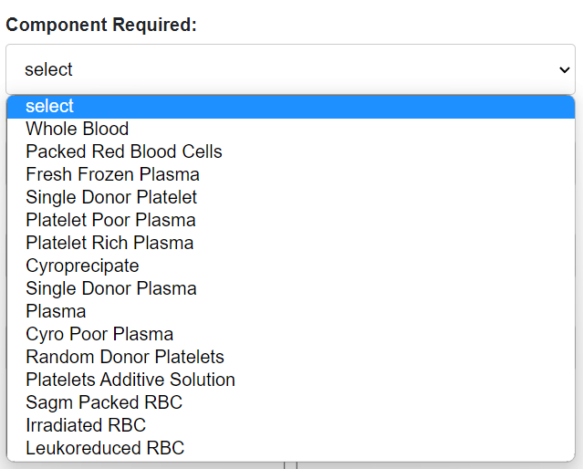
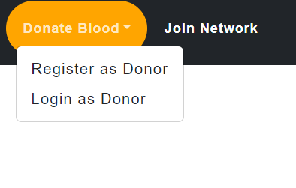


Slide 2
The Need
There is a pressing need for a technological solution that enhances the accessibility of blood donation and bridges the gap between donors, recipients, and blood banks.
Our Solution
Dynamic & innovative website aiming to revolutionize how blood donations are managed & facilitated.

Slide 3




ARCHITECTURE
HTTP
HTTP
Backend
Frontend
End User

Slide 4

KEY FEATURES
01
02
FUTURE PREDICTION
AUTOMATED BRIDGE PROGRAM
03
04
AUTOMATED GRATITUDE EMAIL (with privacy embedded)
EMERGENCY SUPPLY DEMAND

Slide 5
FUTURE SCALABILTY

